Slide 1
Garment Industry Employee Productivity
Tijesunimi Odebode

Slide 2
Introduction
The garment industry is highly labor-intensive
The productivity of employees in garment manufacturing companies affects the ability of the companies to meet the global demand for garment products
If decision makers in the garment industry could analyze and predict employee productivity, this could help improve the overall production of garments and ultimately improve company revenue.
In this project, machine learning will be used to predict actual productivity of garment workers based on certain features in the garment manufacturing process
Rahim, M., Imran, A., & Ahmed, T. (2021). Mining the Productivity Data of Garment Industry. International Journal Of Business Intelligence And Data Mining, 1(1), 1. doi: 10.1504/ijbidm.2021.10028084

Slide 3
Data
date | department | day | team | targeted_ productivity | Over_time | incentive | #_of_workers | Actual_ productivity
2015-01-01 | sweing | Thursday | 8 | 0.80 | 7080 | 98 | 59.0 | 0.940725
2015-01-01 | finishing | Thursday | 1 | 0.75 | 960 | 0 | 8.0 | 0.886500
Table 1: A subset of the Original Garment Industry Employee Productivity Dataset
Table 1 is just a subset of the original dataset. Some rows and columns are not included
Data contains 15 columns and 1197 rows
Data Source: https://archive.ics.uci.edu/ml/datasets/Productivity+Prediction+of+Garment+Employees#

Slide 4
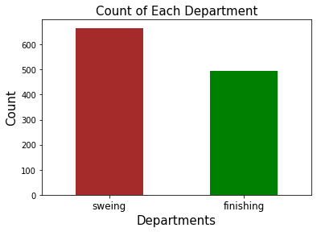

What departments were included in this study?

Slide 5
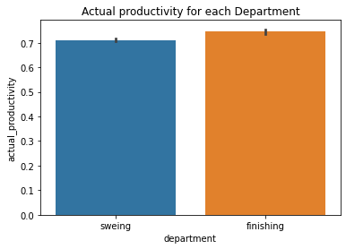
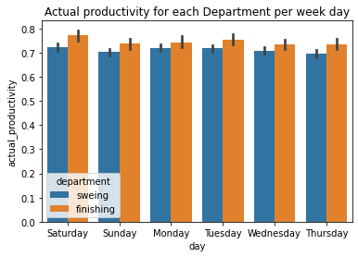
Actual Productivity for each department

Slide 6
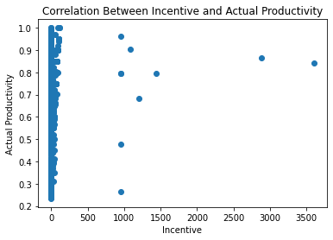
Correlation between Incentive and Actual Productivity

Slide 7
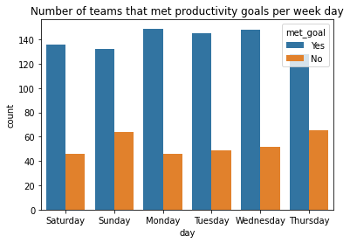
Teams that met productivity goals
team | targeted_productivity | actual_productivity
8 | 0.8 | 0.940725424
1 | 0.75 | 0.8865
11 | 0.8 | 0.800570492
team | targeted_productivity | met_goal
8 | 0.8 | Yes
1 | 0.75 | Yes
11 | 0.8 | Yes

Slide 8
Model
Three models were created: Logistic Regression, KNN and Random Forest
I chose the optimized KNN model because it's the model with the least overfitting. It's training accuracy score was 0.8207 and its testing accuracy score was 0.7517. It's testing score is also not significantly different from the testing scores of the optimized logistic regression model and optimized Random Forest model.
Also, based on the confusion matrices, the KNN model was better at identifying employee teams that met or exceeded their target productivty, which is important for this problem. The KNN model was able to successfully classify 90% of the samples in our test set that were class 1 ('Yes' representing employee teams that met or exceeded their target productivity).

Slide 9
Recommendations
The current optimized KNN model can help decision makers predict employees who are meeting or exceeding their target
The current KNN model may be useful in identifying employees who should be retained because of their high productivity.
It can also be useful in identifying employees who might probably deserve a promotion or salary increase.
It was also clear from this project that the ‘finishing’ department had a higher productivity than the ‘sweing’ department.
For both departments, it looks like actual productivity is highest on Saturdays. It also looks like actual productivity was higher for the finishing department than the sweing department each day.
If Saturday is the first working day of the week in the country where this dataset was gathered, it could be that productivity is higher on Saturdays because workers have had some time to rest before work day.

Slide 10
Thank You!
Email: tijesunimi@yahoo.com
LinkedIn: www.linkedin.com/in/tijesunimi-odebode-ms-phd
Github: https://github.com/todebode

